Slide 1
Advance computer programming final project
John remon maher | 2000150
Mina samer rizk | 2001369
Mario magdy saber | 2000980
Ahmed Mahmoud Hamed Shawareb | 20P7699

Slide 2
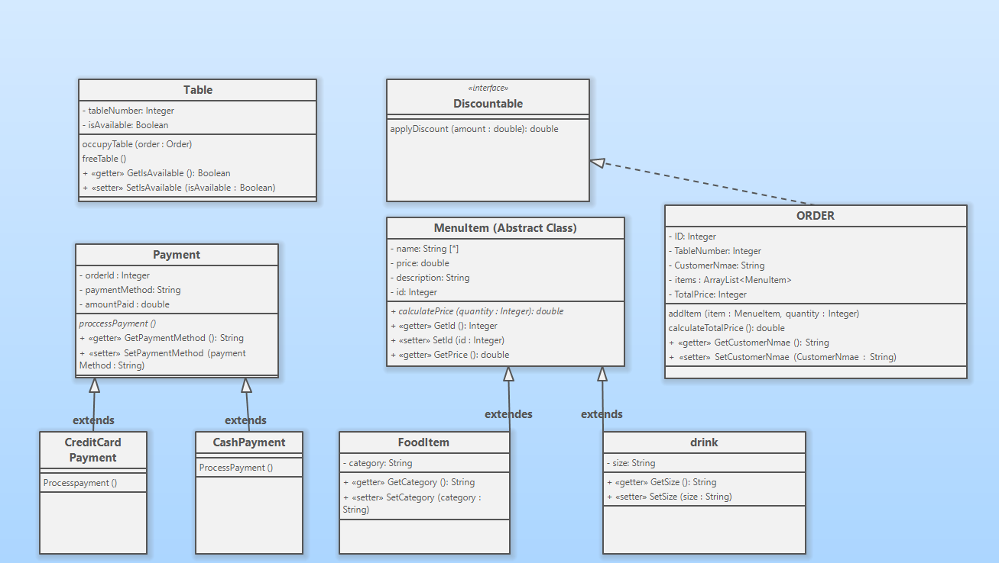

Slide 3
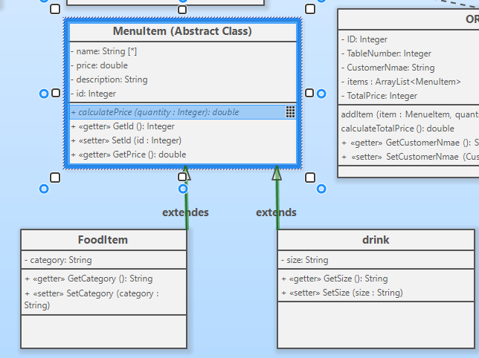

Slide 4
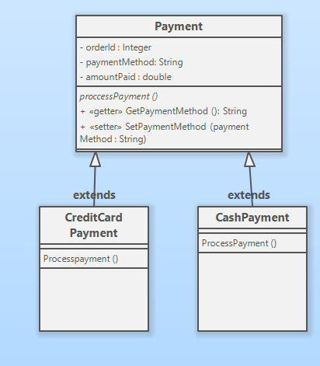

Slide 5
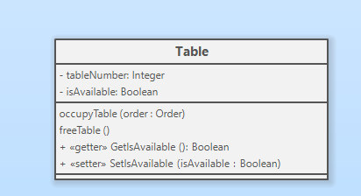

Slide 6
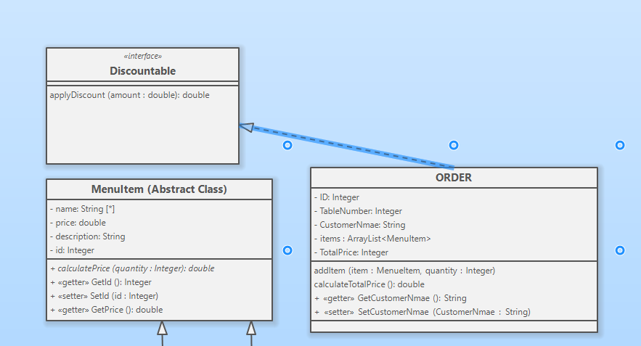

Slide 7
Now lets try the code and then we will discuses how we applied :
1- inheritance
2- polymorphism
3- using concrete or abstract super classes
4- at least one interface
5- using the generic
6- exception handling

Slide 8
How we applied inheritance
As we saw from the uml that fooditem class extends minueitem
And also drink extends minueitem so inheritance was applies also cash payment and credit card payment extends payment

Slide 9
public class FoodItem extends MenueItem
public class Drink extends MenueItem
public class CreditCardPayment extends Payment
public class CashPayment extends Payment

Slide 10
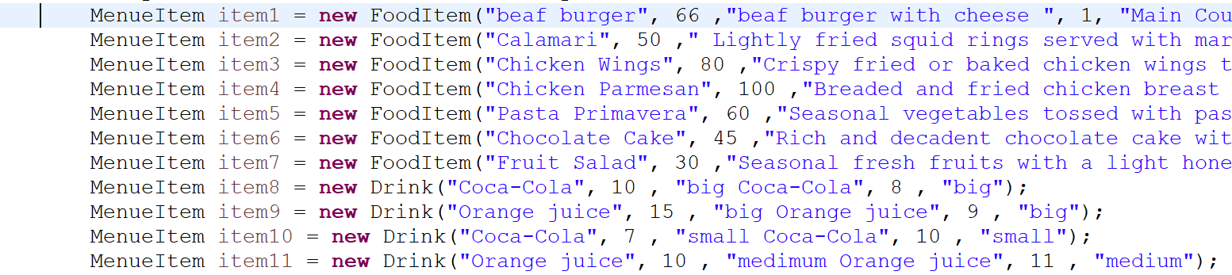
How polymorphism was applies
Polymorphism was applies in many places in the code for example

Slide 11
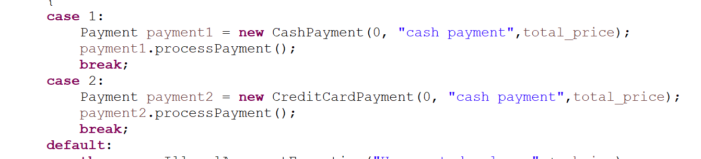

Slide 12
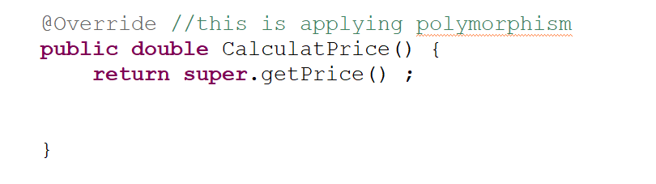
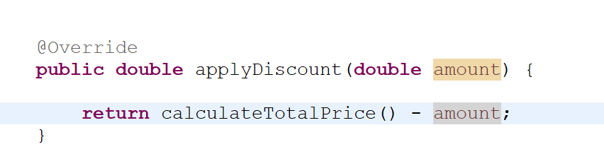
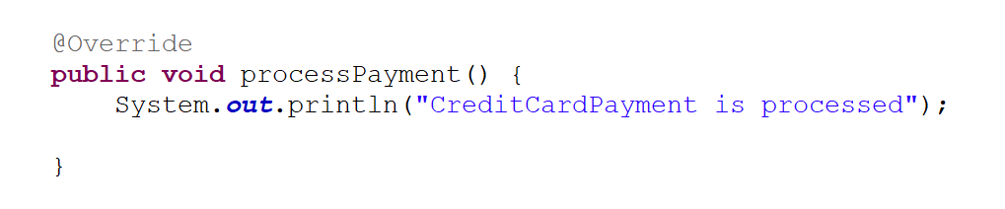

Slide 13

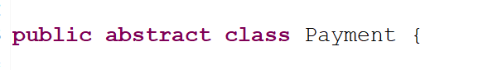
using concrete or abstract super classes
As we saw in the code the minueitem class is an abstract class
And payment class is an abstract class

Slide 14
at least one interface
As we saw in the uml discountable is an interface and order implements it if the order can have discount

Slide 15
using the generic

Slide 16
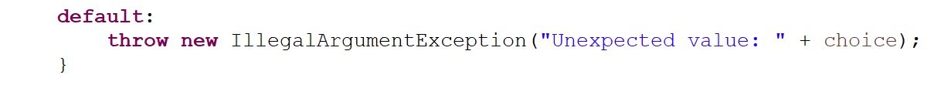
exception handling
There are many exception handling in the code
Every switch statement have a exception as there are many other exceptions

Slide 17
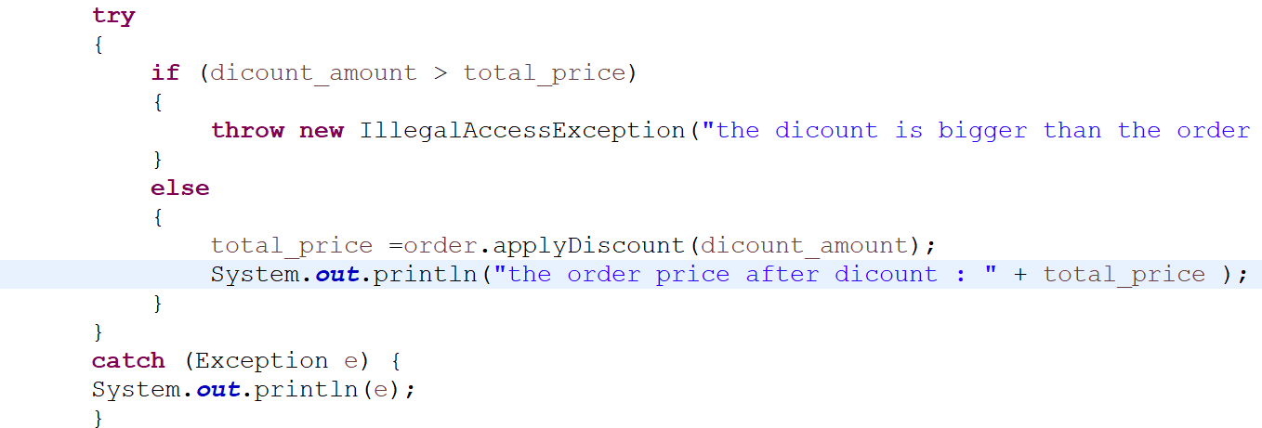

Slide 18

Thanks any questions

